Slide 1




SET CONFERENCE –2020
Predictive Analysis of Heart Diseases Using
Machine Learning Techniques
VELLORE INSTITUTE OF TECHNOLOGY, VELLORE​

Slide 2
PRESENTED BY:
SADHANA.C - 20MDT0022
LOKESH.M - 20MDT0056
AKASH.V- 20MDT0038
UNDER SUPERVISION OF:
PROF. Easwaramoorthy D
SAS SCHOOL,
VELLORE INSTITUTE OF TECHNOLOGY, VELLORE

Slide 3
ABSTRACT
The Heart Disease is the most prominent one among the causes of human deaths across the globe.
The public health care organizations are collecting a large amount of data that include some hidden information, which may be useful for making effective decisions.
In order to achieve the feasible results and to take the consecutive decisions by analyzing the clinical data in the interest of predicting and diagnosing the Heart Diseases.

Slide 4
ABSTRACT CONTD..
The integrated machine learning algorithm is proposed in this research work by using the soft computing techniques such as K Neighbors Classifier, Logistic Regression, Support Vector Classifier, Decision Tree Classifier and Random Forest Classifier.
The purpose of this research work is mainly focus to investigate the various potential supervised statistical algorithms for framing the machine learning based model to analyze and predict the cardiac diseases.

Slide 5




WHY WE GO FOR MACHINE LEARNING AND PLATFORM WE USED?
HEART DISEASES PREDICTION DATASET(from kaggle)
MACHINE LEARNING (with the help of python using ANACONDA (jupyter))
TARGET(class attribute in dataset)

Slide 6
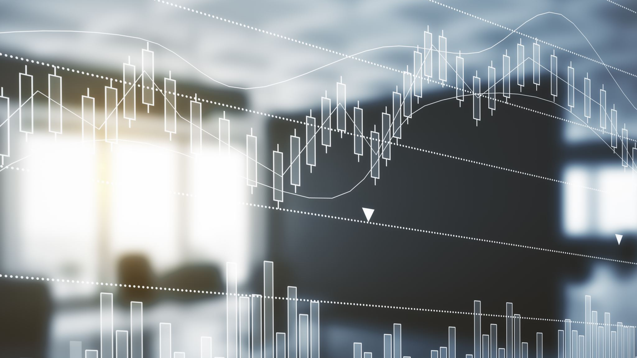
Existing system

Slide 7
EXISTING SYSTEM:
Heart disease can be highlighten as a silent killer which leads to death of a person without obvious symptoms.
This nature of the disease is the cause of growing anxiety about the disease & its consequences. Hence continued efforts are being done to predict the possibility of this deadly disease in prior.
So that various tools & techniques are regularly being experimented to suit the present day health needs.
Machine Learning techniques can be a boon in this regard. Even though heart disease can occur in different forms, there is a common set of core risk factors that influence whether someone will ultimately be at risk for heart disease or not.
By collecting the data from various sources, classifying them under suitable headings & finally analyzing to extract the desired data we can arrive at a conclusion.
This technique can be very well adapted to the do the prediction of heart disease. As the well known quote says
“Prevention is better than cure”, early prediction & its control can be helpful to prevent & decrease the death rates due to heart disease.

Slide 8

PROPOSED SYSTEM

Slide 9
PROPOSED SYSTEM
Heart disease is the leading cause of death among all other diseases, even cancers. Many men & women facing heart disease is on a raise each year. This prompts for its early diagnosis & treatment.
Due to lack of resources in the medical field, the prediction of heart disease occasionally may be a problem. Utilization of suitable technology support in this regard can prove to be highly beneficial to the medical fraternity & patients.
This issue can be resolved by adopting Machine Learning techniques. This paper intends to adopt SVM (Support Vector Machine) , RANDOM FOREST CLASSIFIER, DECISION TREE CLASSIFIER, LOGISTIC REGRESSION & KNN (K-Nearest Neighbor) – 5 techniques for the effective prediction of Heart disease.
It compares the efficiency & accuracy of the 5 techniques to decide among them the best.

Slide 10
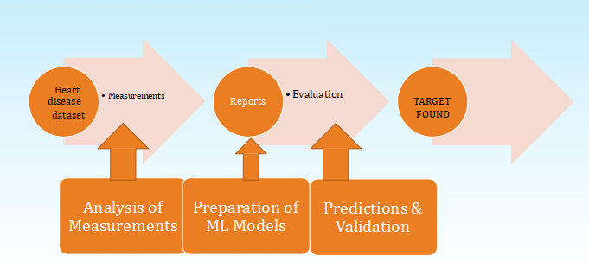
FLOW CHART

Slide 11
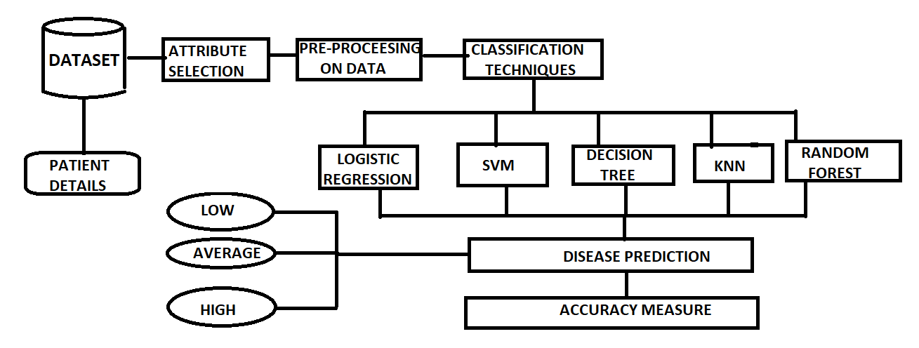
SYSTEM ARCHITECTURE

Slide 12

Dataset Kaggle Platform
We will utilize the HEARY DISEASE dataset from the KAGGLE Machine Learning Repository at https://www.kaggle.com/ronitf/heart-disease-uci The heart disease data includes 303 rows, each with 14 features.

Slide 13
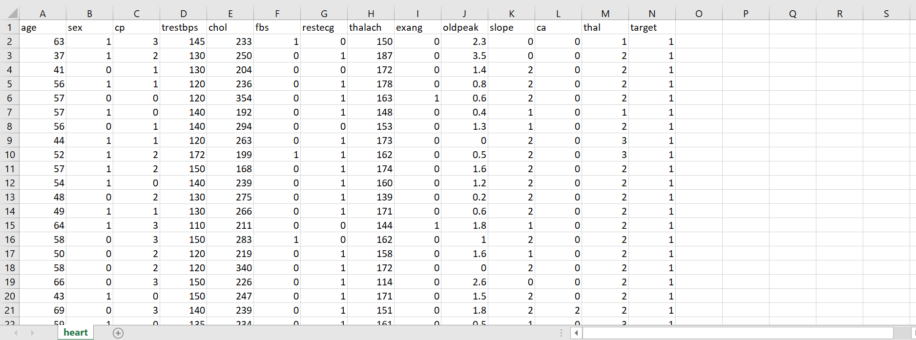
Take a View on Dataset

Slide 14
MOTIVATION
With the help of heart disease dataset.
This paper intends to adopt SVM (Support Vector Machine) , RANDOM FOREST CLASSIFIER, DECISION TREE CLASSIFIER, LOGISTIC REGRESSION & KNN (K-Nearest Neighbor) – 5 techniques for the effective prediction of Heart disease.
It compares the efficiency & accuracy of the 5 techniques to decide among them the best.

Slide 15
WORKING SYSTEM STEP BY STEP
Dataset collection which contains patient details.
Attributes selection process selects the useful attributes for the prediction of heart disease.
After identifying the available data resources, they are further selected, cleaned, made into the desired form.
Data been visualised using library functions like seaborn, matplotlib and so on.
Data had been 70% trained and 30% tested.
Different classification techniques as stated will be applied on preprocessed data to predict the accuracy of heart disease.
Accuracy measure compares the accuracy of different classifiers.

Slide 16
EXPLORING , PREPARING AND VISUALIZING THE DATA
Here, we inserted dataset with help of pandas library function , preprocessing had been taken place after cleaned data's go with some visualization with matplot and seaborn libarary they are,
CO-RELATION
HISTOGRAM
HEATMAP
PAIRPLOT
SCATTER PLOT

Slide 17
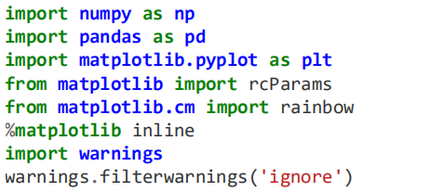
LIBRARY FUNCTIONS OF EXPLORING, PREPARING AND VISUALIZING

Slide 18
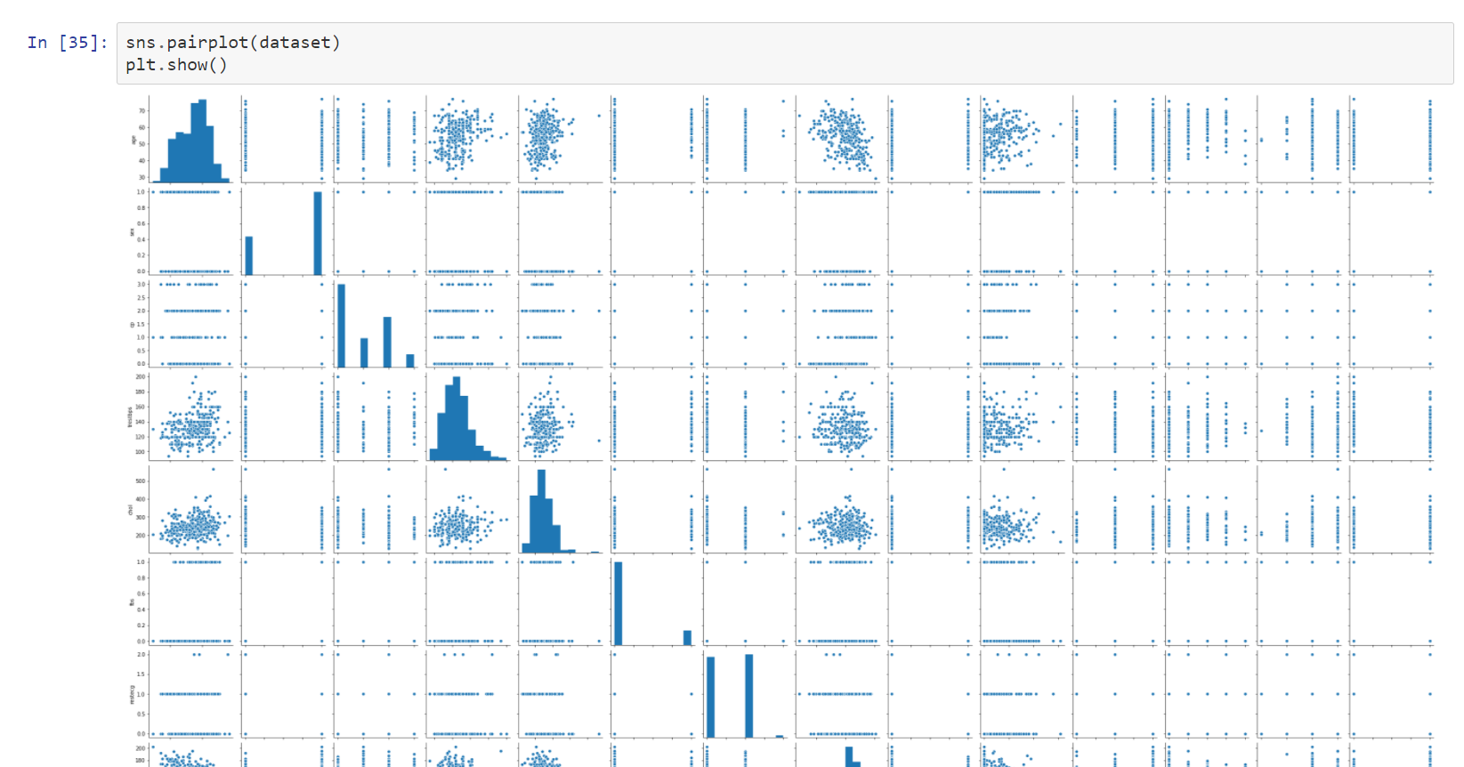
PAIR PLOT DATA
A pairs plot allows us to see both distribution of single variables and relationships between two variables . we use the ‘seaborn’ visualization package to produce a pair-plot. A pair-plot visualizes the relationships between all the features in the data set including the distribution of each feature.

Slide 19
VISUALIZATION OF CO-RELATION (HEAT MAP)
Correlation is used when referencing the strength of a relationship between two variables have a high/strong correlation means.
Heatmap is a two-dimensional graphical representation of data values that are contained in a visualized matrix.
The seaborn Python package allows the creation of heatmaps which can be tweaked using matplotlib tools.

Slide 20
COUNT PLOT
A countplot is kind of likea histogram or a bar graph for some categorical area. It simply shows the number of occurrences of an item based on a certain type of category. ... Countplots are plots that graph a certain column to show the number of times an item occurs in a data set.

Slide 21
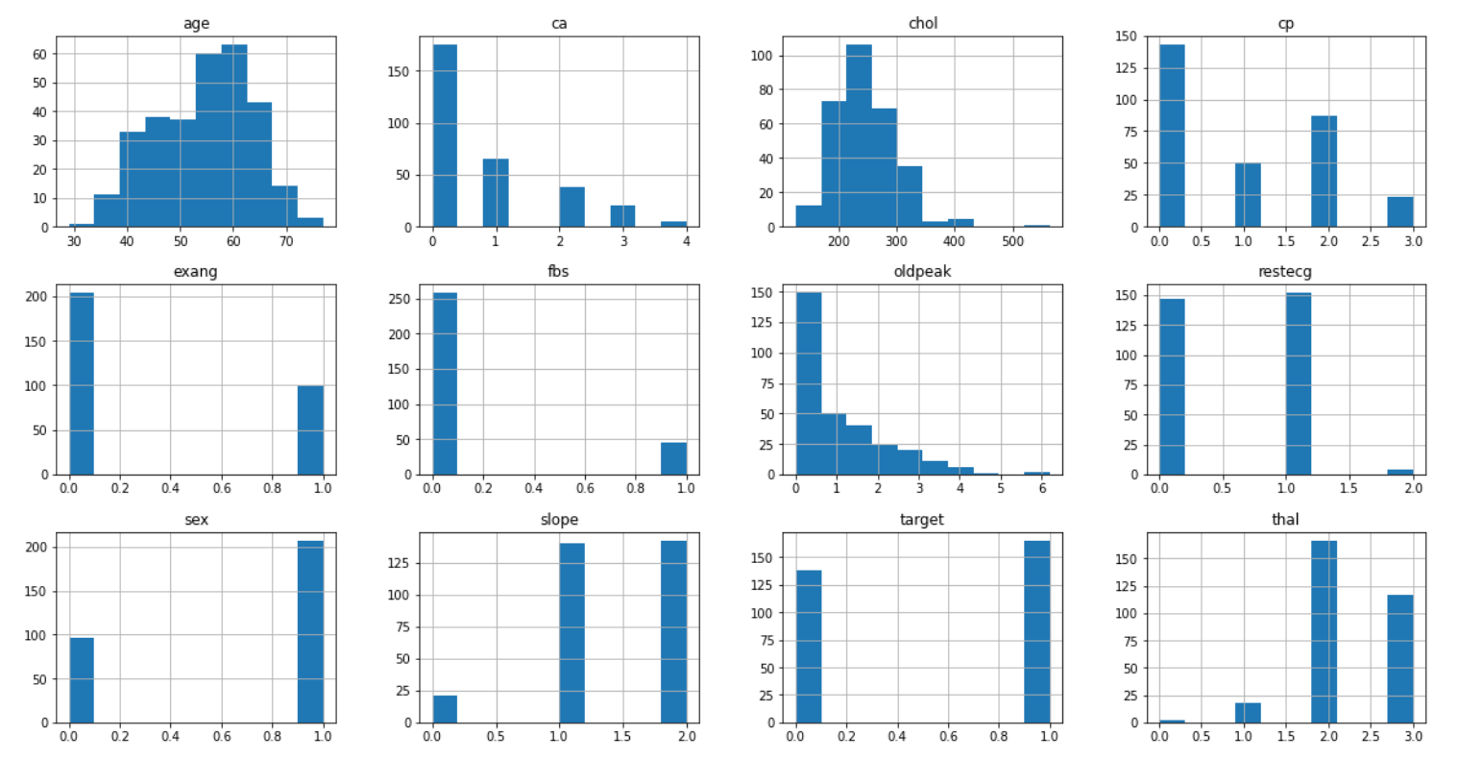
HISTOGRAM PLOT
Histogram: a graphical display of data using bars of different heights. It is similar to a Bar Chart, but a histogram groups numbers into ranges . The height of each bar shows how many fall into each range.

Slide 22
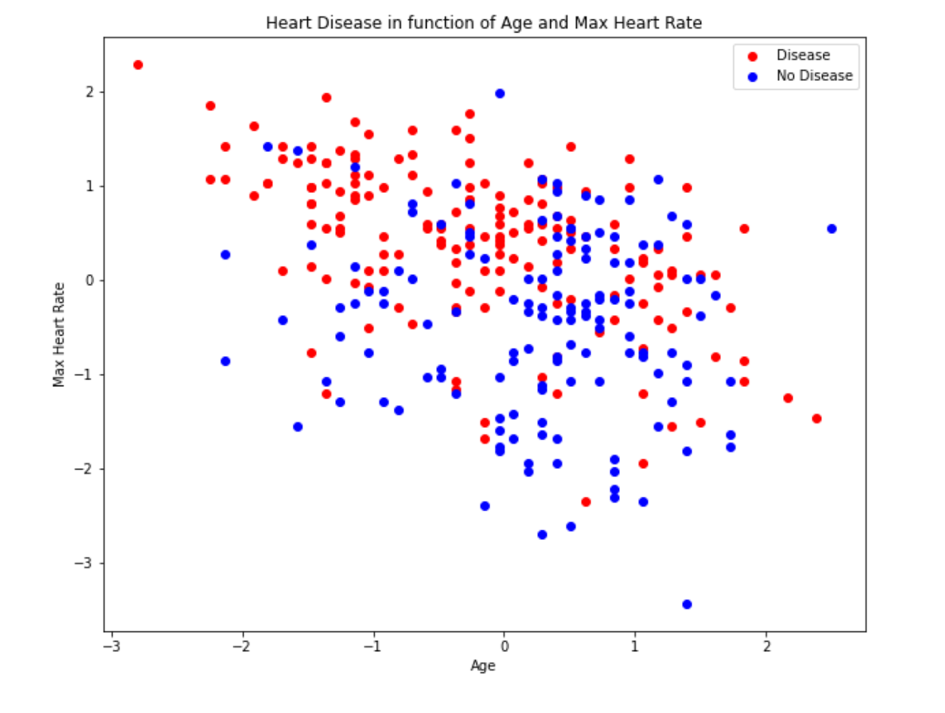
SCATTER PLOT
A Scatter (XY) Plot has points that show the relationship between two sets of data.
Actually this scatter plot shows us clearly about the target class that how many of the person with and without disease.

Slide 23
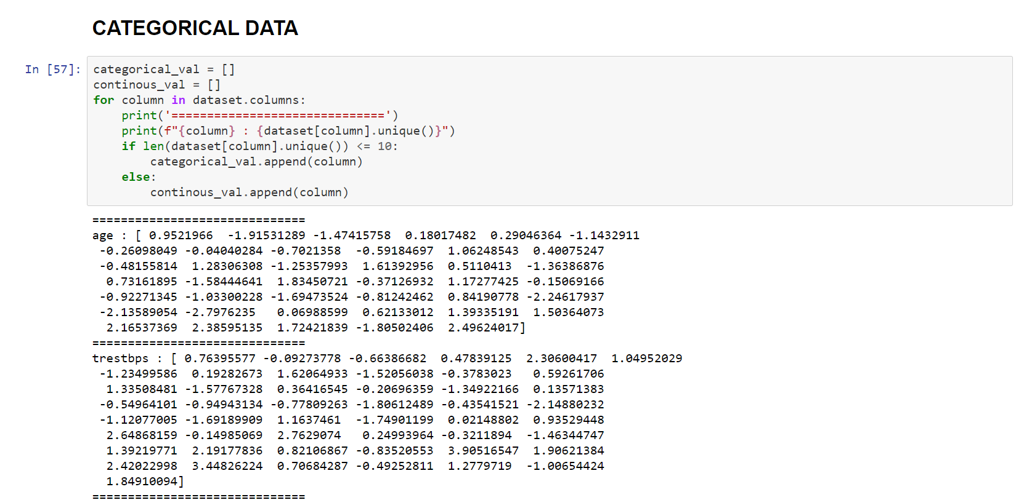
CATEGORICAL DATA

Slide 24
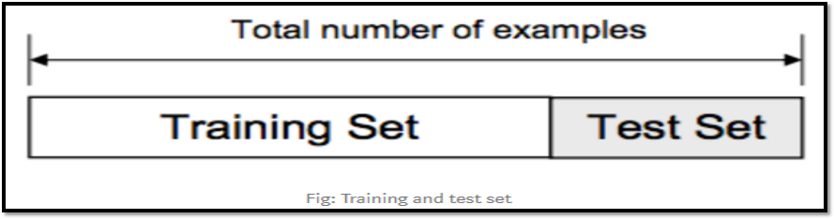
TRAING AND TESTING DATASET
The data we use is usually split into training data and test data. The training set contains a known output and the model learns on this data in order to be generalized to other data later on. We have the test dataset (or subset) in order to test our model’s prediction on this subset.
We will do this using SciKit-Learn library in Python using the train test split method.

Slide 25
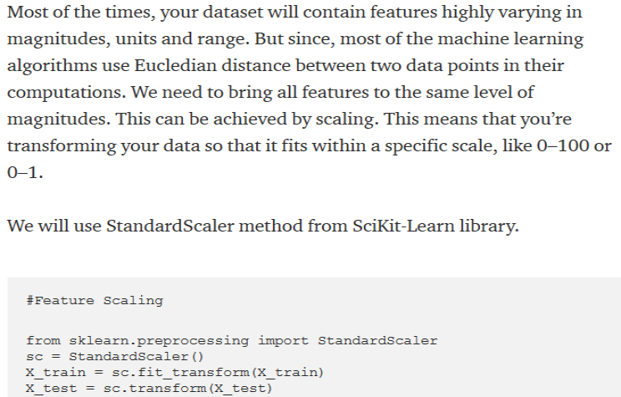
SCALE THE DATA(FEATURE SCALING)

Slide 26
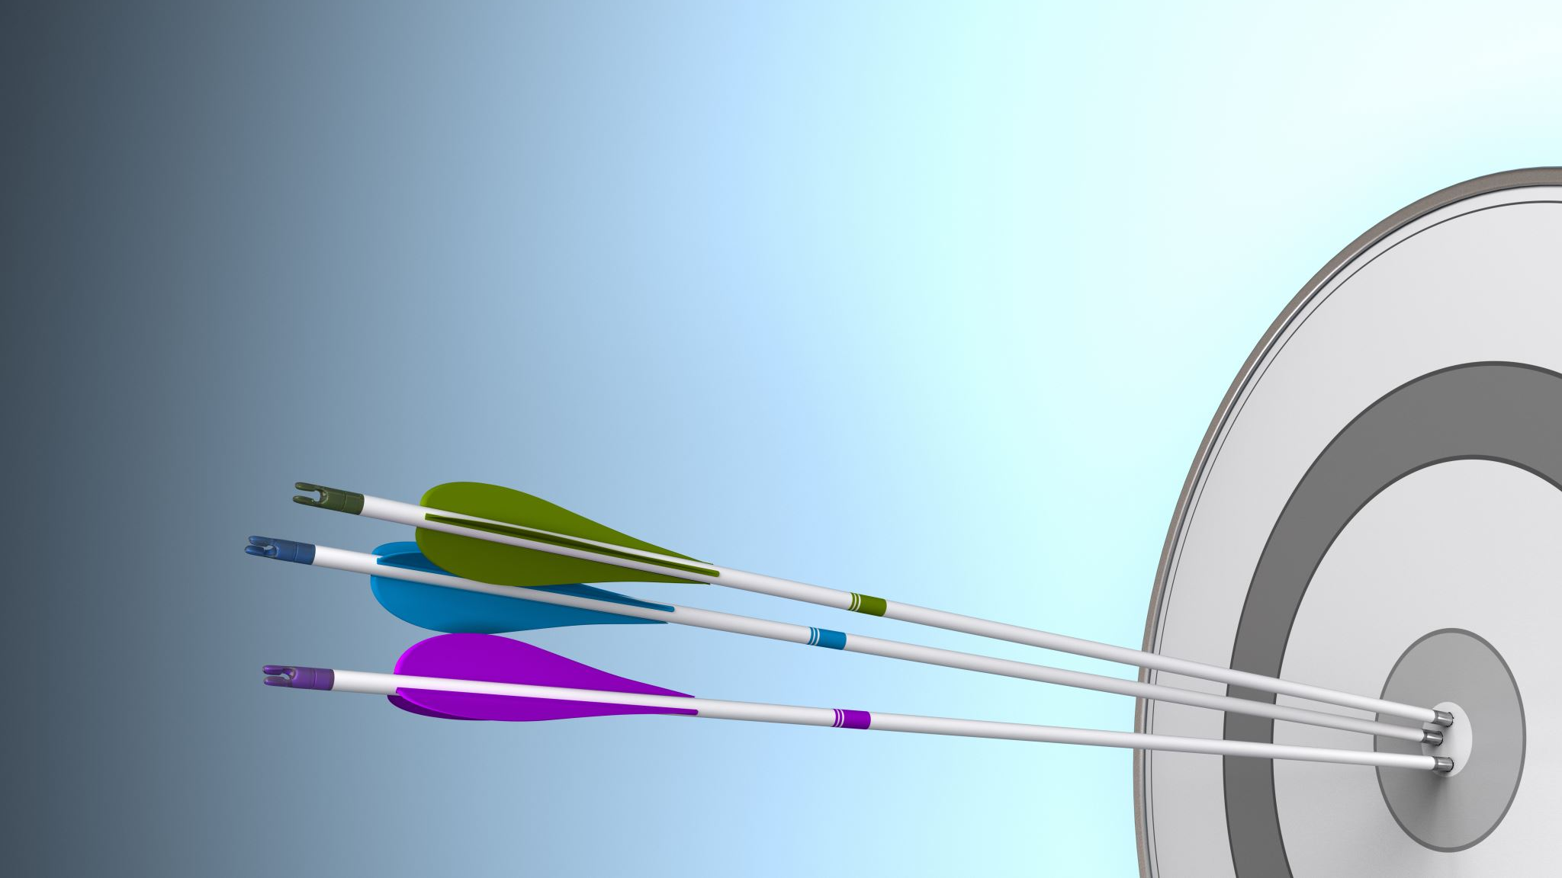
MODEL SELECTION RESULTS
EACH ALGORITHM
ACCURACY LEVEL OF EACH ALGORITHM
ROC_AUC_SCORE OF EACH ALGORITHM
CONFUSION MATRIX WITH PRECISION,RECALL AND F1_SCORE (classification report) OF EACH ONE
FINAL PREDICTION OF ROC_AUC_CURVE

Slide 27
ALGORITHM MODELS LIBRARY FUNCTION
ALGORITHM MODELS
LOGISTIC REGRESSION
RANDOM FOREST
SUPPORT VECTOR CLASSIFIER
K NEAREST NEIGHBOUR
DECISION TREE

Slide 28
ABOUT CONFUSION MATRIX
When we get the data, after data cleaning, pre-processing and wrangling, the first step we do is to feed it to an outstanding model and of course, get output in probabilities. But hold on! How in the hell can we measure the effectiveness of our model. Better the effectiveness, better the performance and that’s exactly what we want. And it is where the Confusion matrix comes into the limelight.
“Confusion Matrix is a performance measurement for machine learning classification”

Slide 29
LOGISTIC REGRESSION CONFUSION MATRIX AND CLASSIFICATION REPORT
Logistic regression is a type of regression analysis in statistics used for prediction of outcome of a categorical dependent variable from a set of predictor or independent variables. In logistic regression the dependent variable is always binary. Logistic regression is mainly used to for prediction and also calculating the probability of success.
ACCURACY SCORE: 85.71%

Slide 30

KNN ALGORITHM CONFUSION MATRIX AND CLASSIFICATION REPORT
K-NN is a non-parametric algorithm, which means it does not make any assumption on underlying data.
It is also called a lazy learner algorithm because it does not learn from the training set immediately instead it stores the dataset and at the time of classification, it performs an action on the dataset.
KNN algorithm at the training phase just stores the dataset and when it gets new data, then it classifies that data into a category that is much similar to the new data.
ACCURACY SCORE: 82.42%

Slide 31
SUPPORT VECTOR MACHINE CONFUSION MATRIX AND CLASSIFICATION REPORT
This classifier aims at forming a hyperplane that can separate the classes as much as possible by adjusting the distance between the data points and the hyperplane. There are several kernels based on which the hyperplane is decided.
The goal of the SVM algorithm is to create the best line or decision boundary that can segregate n-dimensional space into classes so that we can easily put the new data point in the correct category in the future. This best decision boundary is called a hyperplane.
ACCURACY SCORE: 84.615%

Slide 32
RANDOM FOREST CLASSIFIER CONFUSION MATRIX AND CLASSIFICATION REPORT
Random Forest is a classifier that contains a number of decision trees on various subsets of the given dataset and takes the average to improve the predictive accuracy of that dataset." Instead of relying on one decision tree, the random forest takes the prediction from each tree and based on the majority votes of predictions, and it predicts the final output.
The greater number of trees in the forest leads to higher accuracy and prevents the problem of overfitting.
ACCURACY SCORE: 84.62%

Slide 33
DECISION TREE CLASSIFIER CONFUSION MATRIX AND CLASSIFICATION REPORT
The decisions or the test are performed on the basis of features of the given dataset.
It is a graphical representation for getting all the possible solutions to a problem/decision based on given conditions.
ACCURACY SCORE: 76.92%

Slide 34

ROC-AUC CURVE OF MODELS

Slide 35
ROC_AUC CURVE
Receiver Operating Characteristic Curve, calculates the False Positive Rates and True Positive Rates across different thresholds.
We calculated the Area under the Curve or AUC, the AUC is used as a metric to differentiate the prediction power for those with the disease and those without it. Typically a value closer to one means that our model was able to differentiate correctly from a random sample of the two target classes of two patients with and without the disease

Slide 36
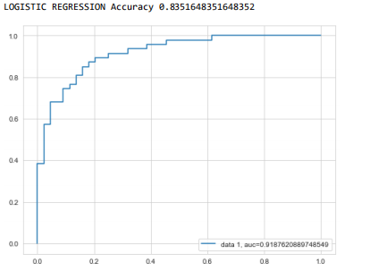
FINAL PREDICTION AND ROC_AUC SCORE OF LOGISTIC REGRESSION
ROC_AUC-SCORE= 0.88975

Slide 37
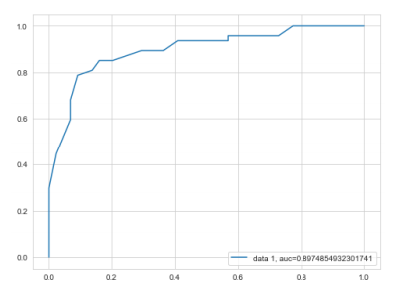
FINAL PREDICTION AND ROC_AUC SCORE OF KNN
ROC_AUC-SCORE= 0.9

Slide 38
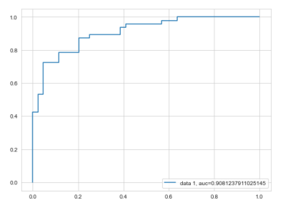
FINAL PREDICTION AND ROC_AUC SCORE OF SVM
ROC_AUC-SCORE= 0.9487

Slide 39
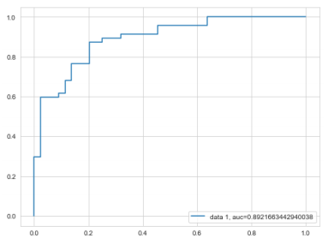
FINAL PREDICTION AND ROC_AUC SCORE OF RANDOM FOREST
ROC_AUC-SCORE= 0.9795

Slide 40
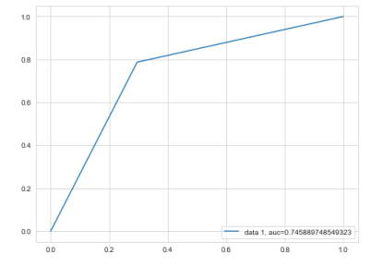
FINAL PREDICTION AND ROC_AUC SCORE OF DECISION TREE
ROC_AUC-SCORE= 0.94

Slide 41

RESULTS VIA GRAPHS

Slide 42
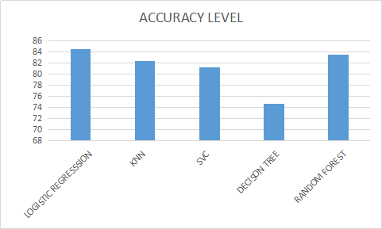
GRAPHICAL REPRESENTATION OF ACCURACY LEVEL TO LR, RF, KNN,SVC, DT
LR- LOGISTIC REGRESSION
KNN- K NEAREST NEIGHBOUR
SVC- SUPPORT VECTOR CLASSIFIER
DT- DECISION TREE
RF- RANDOM FOREST

Slide 43
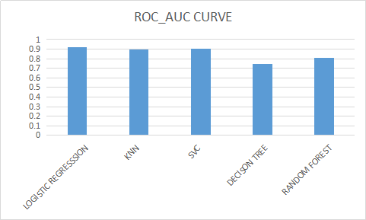
GRAPHICAL REPRESENTATION OF ROC_AUC SCORE TO LR, RF, KNN,SVC, DT
LR- LOGISTIC REGRESSION
KNN- K NEAREST NEIGHBOUR
SVC- SUPPORT VECTOR CLASSIFIER
DT- DECISION TREE
RF- RANDOM FOREST

Slide 44
CONCLUSION
This project tells us the heart disease prognostication using machine learning techniques. Being, used five algorithms called Random Forest, Logistic algorithm, SVC, Decision Tree Algorithm, KNN algorithm are been used to check and find accuracy level of that, which will help us to compare each and every algorithm accuracy rate to tell which is best suitable and predictable one i.e., Logistic Regression Algorithm provides 85.7% accuracy when compare to other so this is the best suitable algorithm for prediction.

Slide 45
Merits of Heart Disease Prediction Using Machine Learning
1. Increased accuracy for effective heart disease diagnosis.
2. Handles roughest(enormous) amount of data using random forest algorithm and feature selection.
3. Reduce the time complexity of doctors.
4. Cost effective for patients.

Slide 46
Demerits of Heart Disease Prediction Using Machine Learning
1. Prediction of cardiovascular disease results is not accurate.
2. Data mining techniques does not help to provide effective decision making.
3. Cannot handle enormous datasets for patient records.
4. Major disadvantage is to over-fitting. And it’s not so easy to implement

Slide 47
FUTURE WORK
In the future, we can analyze other classifiers and develop a hybrid model for Heart disease prediction. Heart Disease has provided many studies in recent years, through different approaches as computing vision, classification, and prediction. As a future work, we considered an improvement in predictions, testing and with neural networks which we can go with deep learning approaches in databases containing.

Slide 48
REFERENCE
[1].M. Marimuthu, S. Deivarani, Analysis of Heart Disease Prediction using Various Machine Learning Techniques, 5, 2019.
[2].Nimai Chand Das Adhikari, Arpana Alka, and Rajat Garg, HPPS: Heart Problem Prediction System using Machine Learning.
[3].Adil Hussain She, Pawan Kumar Chaurasia, A Review on Heart Disease Prediction Using Machine Learning Techniques, 9(4), 2019.
[4].Navdeep Singh et al., Genetic algorithm and Naive Bayes GA, 2020.
[5].Sarangam Kodati et al., Decision Table Easy to draw and easy to change, 2019.
[6].R. Sharmila, S. Chellammal, A conceptual method to enhance the prediction of heart diseases using the data techniques, International Journal of Computer Science and Engineering, 2018.
[7].Jayami Patel, Tejal Upadhay, Heart disease Prediction using Machine Learning, 2017.
[8].Boshra Brahmi, Mirsaeid Hosseini Shirvani, Prediction and Diagnosis of Heart Disease by Data Mining Techniques, 2015.
[9].M. Marimuthu, M. Abinaya, K.S. Hariesh, K. Madhankumar, V. Pavithra, A Review on Heart Disease Prediction using Machine Learning and Data Analytics Approach, 181(18), 2018.
[10].Ashwini Shetty , Chandra Naik, Different Data Mining Approaches for Predicting Heart Disease, 5 (9), 2016.
[11].Navdeep Singh Sidhu1, Sunil Kumar, Kondethim mannahall Rangaiah, Dwarikaprasad Ramesh, Kumaraswamy Veerappa, Cholenahally Nanjappa Manjunath Clinical Medicine Insights: Cardiology, 14(7), 2020.
Kaggle:https://www.kaggle.com/ronitf/heart-disease-uci

Slide 49

THANK YOU

